Slide 1



Razor views
Team Members:
Harika Naidu Sai Tejaswini Narne Sonam Gadekari

Slide 2
Objectives
Introduce Razor Views
Introduction to Razor Syntax
Explain Razor syntax in .NET MVC
Harika Naidu.

Slide 3
Razor Views
Razor is a markup syntax that lets you embed server-based code into web pages using C# .
Razor is not a programming language. It is a server side markup language.
Razor uses a Syntax similar to the PHP and Classic ASP.
Harika Naidu.

Slide 4
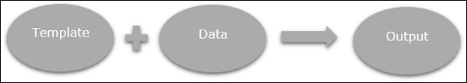
Razor Views
Razor can be used anywhere to generate output like HTML.
Razor is based on the ASP.NET, and used for creating the web based applications.
Harika Naidu.

Slide 5
@ character
@ character is used to insert server side code
Single statement blocks
@ {var Message=“I need a six month vacation”;}
Multi-statement blocks
@ {
var Message=“I need a six month vacation”;
var time=“ Twice a year”;
var totalMessage = Message + time + ”☺”;
}
Harika Naidu.

Slide 6
Types of Razor Expressions:
There are two different types of Razor Expressions.
1. Implicit Razor Expression.
<p>@DateTime.Now</p>
<p>@DateTime.IsLeapYear(2016)</p>
2. Explicit Razor Expression.
<p>Last week this time: @(DateTime.Now - TimeSpan.FromDays(7))</p>
Harika Naidu.

Slide 7
Razor C# Variables:
The variables are use to store the data
Datatypes:
int, float, decimal, bool, float, string.
Operators:
C# supports many operators like +, =, -, etc.,
Harika Naidu.

Slide 8
Razor Syntax
Sai Tejaswini Narne

Slide 9
Razor Syntax
Razor code blocks are enclosed in @{ ... }
Inline expressions (variables and functions) start with @
Code statements end with semicolon
Variables are declared with the var keyword
Strings are enclosed with quotation marks
C# code is case sensitive
C# files have the extension .cshtml
Sai Tejaswini Narne

Slide 10
Razor Syntax
The Razor syntax consists of Razor markup, C#, and HTML.
Razor web pages can be described as HTML pages with two kinds of content: HTML content and Razor code.
Razor Syntax is based on ASP.NET framework, the part of the Microsoft.NET Framework that’s specifically designed for creating web applications.
The Razor syntax gives you all the power of ASP.NET, but is using a simplified syntax that’s easier to learn if you’re a beginner, and makes you more productive if you’re an expert.
Sai Tejaswini Narne

Slide 11
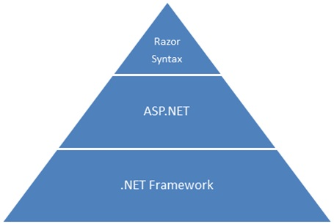
Sai Tejaswini Narne

Slide 12
Advantages of Razor Syntax
It is light weight and it has a simple syntax.
It is easier to understand Razor syntax as compared to ASPX view engine syntax.
Provides automatic encoding of HTML output.
Provides great readability of markup and code.
Razor does not require any special tool to write markup. We can also write our markup code with any old plain text editor like Notepad.
Easy to Learn: Razor is easy to learn. We can also use our existing HTML skills.
Sai Tejaswini Narne

Slide 13
If and Else Conditions
@{ var txt = ""; if(DateTime.Now.Hour > 12) {txt = "Good Evening";} else {txt = "Good Morning";} } <html> <body> <p>The message is @txt</p> </body> </html>
Output: The message is Good Evening
Sai Tejaswini Narne

Slide 14
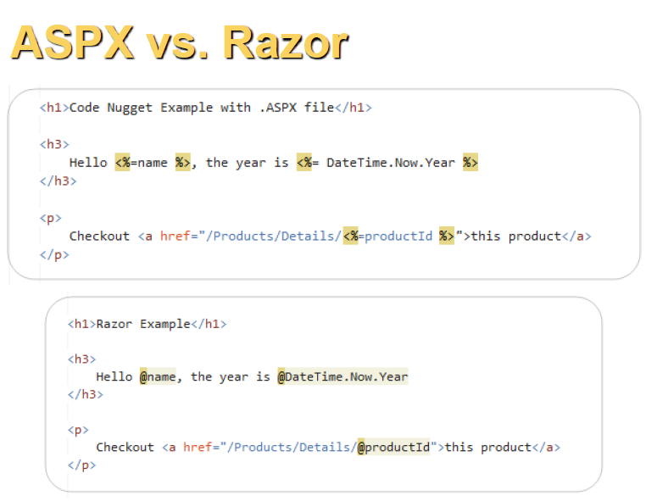
Sonam Gadekari

Slide 15
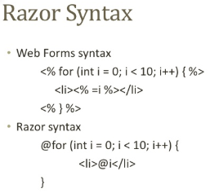
For loop:
Sonam Gadekari

Slide 16
Comments
@{
@* This is a comment. *@
@* var theVar = 17; *@
}
@*
This is a multiline code comment.
It can continue for any number of lines.
*@
@* A one-line code comment. *@
@{
// This is a comment.
var myVar = 17;
/* This is a multi-line comment
that uses C# commenting syntax. */
}
Sonam Gadekari

Slide 17
References:
https://www.w3schools.com/asp/razor_intro.asp
https://docs.microsoft.com/en-us/aspnet/core/mvc/views/razor?view=aspnetcore-2.2#razor-syntax
https://www.tutorialspoint.com/asp.net_mvc/asp.net_mvc_razor.htm
https://en.wikipedia.org/wiki/ASP.NET_Razor

Slide 18


Slide 19


